Slide 1

Employment Wages in Education versus the County
CIS 5560
Professor Woo
Group 4
Grace Mayorga & Jeffrey Dang

Slide 2

Agenda
Project overview and objective
Dataset details
Technical implementation
Regression models
Analysis
Github

Slide 3
Overview
Education System
California State University
University of California
Community Colleges
K-12
County
California counties

Slide 4
Project Objective
Build various models to compare salaries, positions and wages at different educational institutions in California to compare versus working for the County
Helps job seekers find positions that fit best with their expectations in pay

Slide 5
Dataset Details
Datasets: Compensation for California State University, Community College District, K-12 Education, University of California, County Data
Total dataset size: 2GB
Dataset sources: California State Controller https://publicpay.ca.gov/Reports/RawExport.aspx

Slide 6
Technical Implementation Process
Identify
Identify project objective and look for data sources
Review
Review data to have an understanding
Prepare and clean
Prepare and clean the data by removing columns not related to analysis
Split
Split the data and prepare to train the model
Train, test and validate
Train, test and validate our models
Deploy
Deploy models and use measures for accuracy

Slide 7
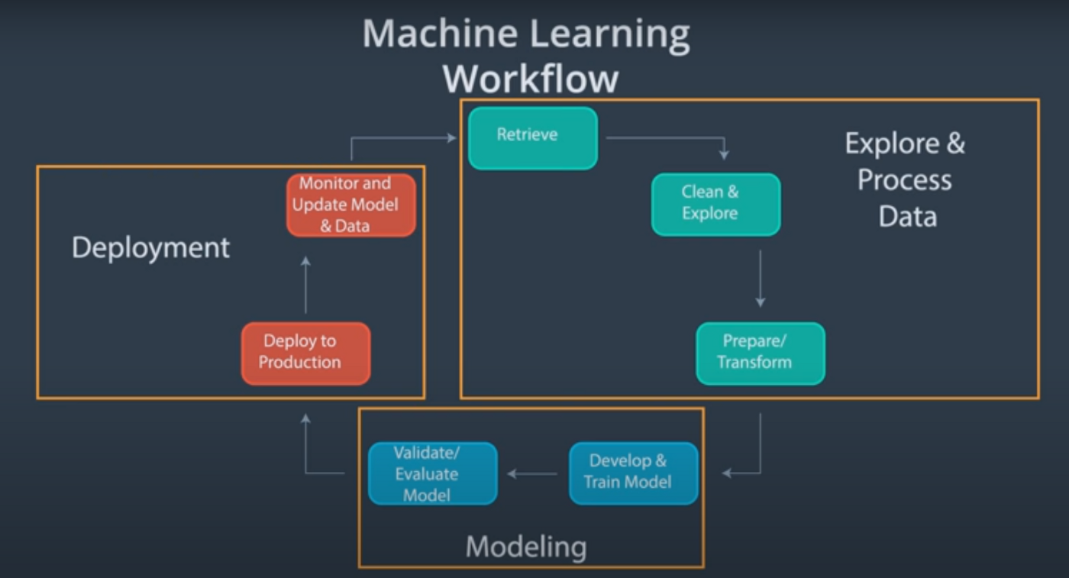

Slide 8

Spark ML
Apache Spark 3.2.1, Scala 2.12
Open source
Used for big data workloads
File system: Databricks File System

Slide 9


PySpark & Databricks
A collaboration of Apache Spark and Python
Mainly used for processing datasets
Databricks provides a unified, open platform for all data types

Slide 10

Zeppelin
Web-based notebook that enables interactive data analytics
Some programming languages that can be used within the notebook are:
Python, Scala, Hive, SparkSQL, shell and markdown

Slide 11

Hadoop
Hadoop is an open-source framework used to store and process large datasets
File System: HDFS
Benefits are:
Widely Used
Scalable
Open Source
Fault Tolerant

Slide 12
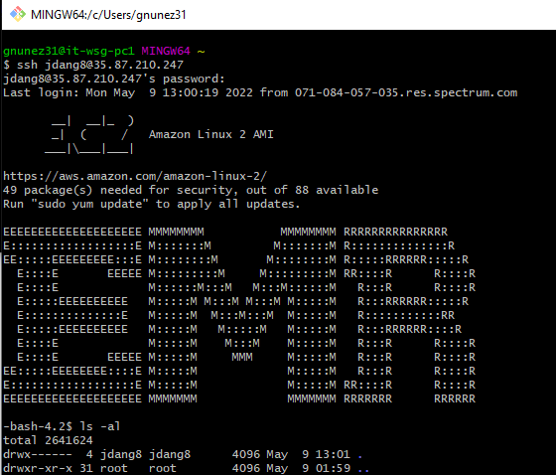
Command Line Interface (CLI)
Computer program that allows:
Creating files
Deleting files
Run programs
Navigate folders/files
Windows: Command Prompt
Mac: Terminal
Gitbash

Slide 13
Machine Learning Algorithms
Linear Regression
Random Forest Regression
Gradient Boost Tree Regression

Slide 14
Root Mean Square Error (RMSE)
Measures the difference between predicted values and measured values
Rule of thumb: Values between 0.2 and 0.5 show that model can predict data accurately

Slide 15
R-squared (R2)
A statistical measure used to identify the variation of a dependent variable explained with an independent variable
Coefficient of determination
Ideal accuracy is 1

Slide 16

Columns used for Analysis
Employer Name
Position
Minimum Salary
Maximum Salary
Regular Pay
Total Wages

Slide 17
Random Forest Regression
Supervised learning algorithm that uses ensemble learning method for regression
Operates by constructing several decision trees during training and outputs the prediction of all the trees

Slide 18
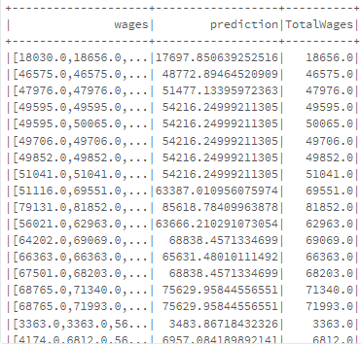
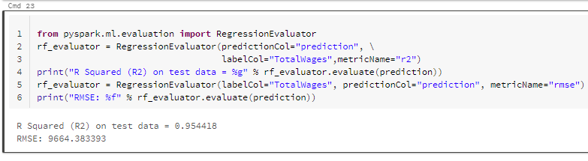
Databricks: RF Regression
Random split: 70/30
R2: 0.954418
RMSE: 9664.383393

Slide 19
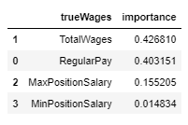
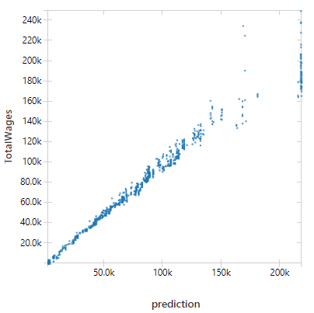
Random Forest
Important Features
Prediction

Slide 20
Random Forest Regression (RF)
County
Year​ | RMSE​ | R2​
2015​ | ​9664.383393 | 0.954418​
2016​ | ​9614.053923 | 0.958966​
2017​ | ​10392.657773 | 0.95424​
2018​ | ​11716.424133 | 0.947753​
2019​ | ​12221.279307 | 0.946432​
2020​ | ​11276.248549 | 0.951583​

Slide 21
Random Forest Regression (RF)
Community Colleges
Year​ | RMSE​ | R2​
2015​ | ​4964.864045 | 0.983294​
2016​ | ​4956.428644 | ​0.984146
2017​ | ​4930.236989 | 0.985197​
2018​ | ​5507.724890 | 0.982848​
2019​ | ​5297.995243 | 0.985257​
2020​ | ​6041.622809 | 0.983661​

Slide 22
Random Forest Regression (RF)
California State University
Year​ | RMSE​ | R2​
2015​ | ​5482.601551 | ​0.975344
2016​ | ​5268.146617 | 0.978588​
2017​ | ​6057.410605 | 0.974154​
2018​ | ​5567.684305 | 0.979626​
2019​ | ​5857.078388 | 0.978864​
2020​ | ​6255.007294 | 0.978342​

Slide 23
Random Forest Regression (RF)
University of California
Year​ | RMSE​ | R2​
2015​ | ​36294.132007 | 0.702157​
2016​ | ​34559.629815 | 0.737277​
2017​ | ​38513.698182 | ​0.711773
2018​ | ​41336.104790 | ​0.693858
2019​ | ​39786.159150 | ​0.727709
2020​ | ​40205.660854 | 0.741234​

Slide 24
Random Forest Regression (RF)
K-12
Year​ | RMSE​ | R2​
2015​ | ​4657.606924 | 0.98306​
2016​ | ​4446.180096 | 0.98565​
2017​ | ​4945.365190 | 0.983103​
2018​ | ​4978.002308 | 0.983555​
2019​ | ​4574.559808 | 0.986668​
2020​ | ​4861.774314 | 0.985669​

Slide 25
Gradient Boost Tree (GBT)

Slide 26

Gradient Boost Tree (GBT)
Ensemble method that performs regression or classification by combining the outputs from individual trees

Slide 27
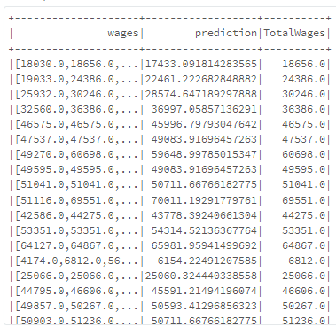
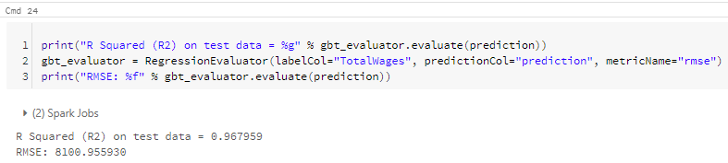
Databricks: GBT Regression
Random split: 70/30
R2: 0.967959
RMSE: 8100.955930

Slide 28
Gradient Boost Tree(GBT) County
Year | RMSE | R2
2015 | 8100.955930 | 0.967959
2016 | 8566.399668 | 0.977438
2017 | 9470.572120 | 0.962402
2018 | 9996.982998 | 0.961734
2019 | 10551.673104 | 0.960159
2020 | 10751.715132 | 0.963403

Slide 29
Gradient Boost Tree(GBT) Community Colleges
Year | RMSE | R2
2015 | 4357.890394 | 0.987266
2016 | 4876.166985 | 0.984922
2017 | 4161.825623 | 0.989217
2018 | 4280.351067 | 0.989455
2019 | 4450.777323 | 0.989534
2020 | 5196.994302 | 0.987977

Slide 30
Gradient Boost Tree(GBT) California State University
Year | RMSE | R2
2015 | 5043.618726 | 0.979843
2016 | 5137.303928 | 0.980198
2017 | 4728.100640 | 0.983964
2018 | 5616.566695 | 0.979174
2019 | 5043.618726 | 0.979843
2020 | 5622.748763 | 0.982566

Slide 31
Gradient Boost Tree(GBT) University of California
Year | RMSE | R2
2015 | 22926.722380 | 0.873488
2016 | 28476.879449 | 0.826652
2017 | 28619.997665 | 0.841139
2018 | 31516.986030 | 0.826116
2019 | 28798.057255 | 0.857987
2020 | 30255.308848 | 0.85542

Slide 32
Gradient Boost Tree(GBT) K-12
Year | RMSE | R2
2015 | 4042.455556 | 0.987243
2016 | 3743.382389 | 0.989866
2017 | 4019.258332 | 0.988861
2018 | 4007.670976 | 0.989255
2019 | 4016.461240 | 0.989761
2020 | 3908.018342 | 0.989436

Slide 33
Linear Regression

Slide 34
Linear Regression
Simplest and most used form of regression analysis
Supervised machine learning model
Goal is to have model be as close to data as possible

Slide 35
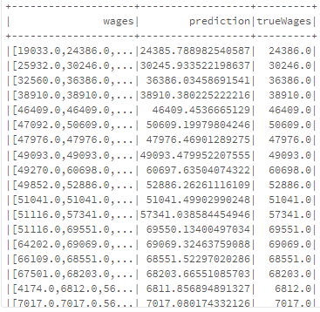
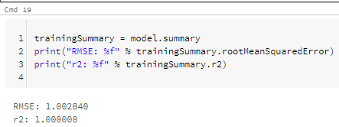
Databricks: Linear Regression
Random split: 70/30
R2: 1.002840
RMSE: 1.00000

Slide 36
Linear Regression County
Year​ | RMSE​ | R2​
2015​ | ​1.002840 | 1.00​
2016​ | ​0.973778 | 1.00​
2017​ | ​0.952207 | 1.00​
2018​ | ​0.951497 | 1.00​
2019​ | ​0.959617 | 1.00​
2020​ | ​0.973778 | 1.00​

Slide 37
Linear Regression Community Colleges
Year​ | RMSE​ | R2​
2015​ | ​1.875100 | 1.00​
2016​ | ​1.828888 | ​1.00
2017​ | ​1.981780 | 1.00​
2018​ | ​1.856770 | 1.00​
2019​ | ​2.005357 | 1.00​
2020​ | ​1.853928 | 1.00​

Slide 38
Linear Regression California State University
Year​ | RMSE​ | R2​
2015​ | ​1.861691 | 1.00​
2016​ | ​1.857579 | 1.00​
2017​ | ​1.878590 | ​1.00
2018​ | ​1.846675 | 1.00​
2019​ | ​1.944714 | ​1.00
2020​ | ​1.869693 | ​1.00

Slide 39
Linear Regression University of California
Year​ | RMSE​ | R2​
2015​ | ​0.661359 | ​1.00
2016​ | ​0.641338 | 1.00​
2017​ | ​0.648199 | ​1.00
2018​ | ​0.641617 | 1.00​
2019​ | ​0.633842 | 1.00​
2020​ | ​0.661958 | 1.00​

Slide 40
Linear Regression K-12
Year​ | RMSE​ | R2​
2015​ | ​2.364032 | 1.00​
2016​ | ​2.112825 | 1.00​
2017​ | ​2.145450 | 1.00​
2018​ | ​2.285882 | ​1.00
2019​ | ​2.297404 | ​1.00
2020​ | ​2.537647 | ​1.00

Slide 41
Comparison of Models Sample
Using County 2015 data
 | Random Forest | Gradient Boost Tree | Linear Regression
R2 | 0.954418 | 0.967959 | 1.000000
RMSE | 9664.383393 | 8100.955930 | 1.002840

Slide 42
GitHub
Github URL: https://github.com/gnunez8/CIS5560-Project.git

Slide 43
References
Classification and Regression: https://spark.apache.org/docs/latest/ml-classification-regression.html
MAE, MSE, RMSE, Coefficient of Determination, Adjusted R-Squared-Which metric is better?: https://medium.com/analytics-vidhya/mae-mse-rmse-coefficient-of-determination-adjusted-r-squared-which-metric-is-better-cd0326a5697e

Slide 44
Thank you

